Slide 1
CONTINUUM
WORKSHOP-2
Introduction to OpAmps

Slide 2

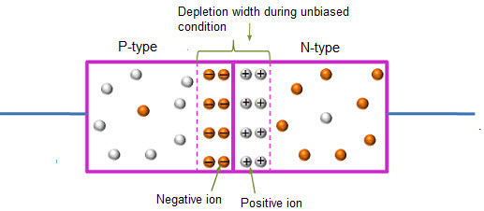


WHAT IS DIODE?
2
Electronic devices created by bringing together a p-type and n-type region within the same semiconductor lattice. Used for rectifiers, LED etc. It is represented by symbol

Slide 3
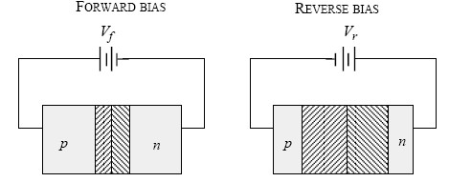
Biasing of Diode
4
Forward Bias : Connect positive of the Diode to positive of supply…negative of Diode to negative of supply
Reverse Bias: Connect positive of the Diode to negative of supply…negative of diode to positive of supply.

Slide 4
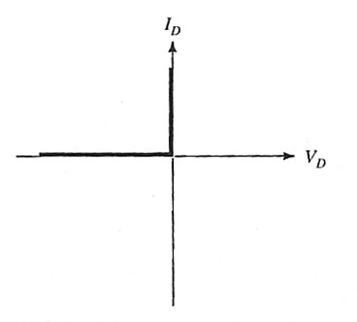
I-V characteristics of Ideal diode

Slide 5




Characteristics of Ideal Diode
» Conducts in one direction.
» Conduct current when “Forward Biased” ( Zero resistance/Short circuit)
» Do not conduct when “Reverse Biased”
(Infinite resistance/Open circuit)

Slide 6
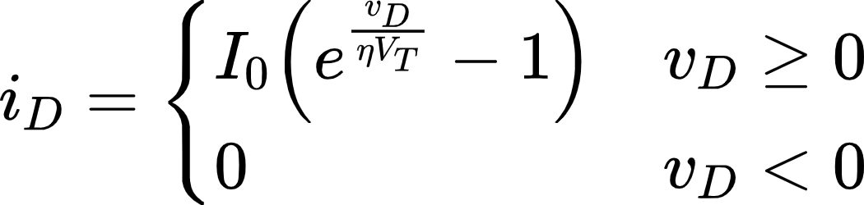
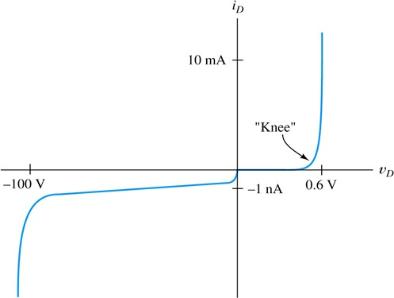



I-V characteristics of a practical diode

Slide 7
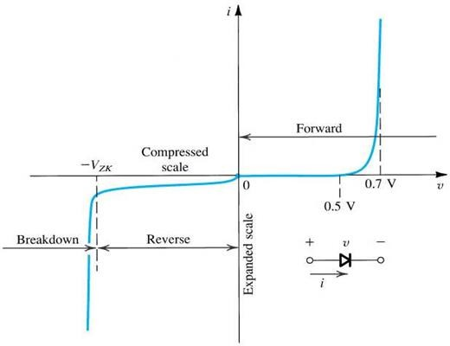
I-V Characteristics

Slide 8
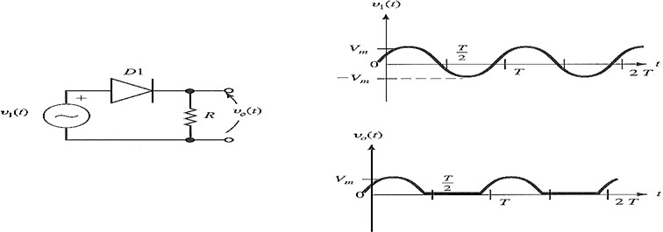



Half-wave Rectification
» Simplest process used to convert ac to dc.
» A diode is used to clip the input signal excursions of one polarity to zero.

Slide 9
Operational Amplifiers
10
_
+

Slide 10




















Slide 11
Operational Amplifiers
Usually Called Op Amps
An amplifier is a device that accepts a varying input signal and produces a similar output signal with a larger amplitude.
Usually connected so part of the output is fed back to the input. (Feedback Loop)
Most Op Amps behave like voltage amplifiers. They take an input voltage and output a scaled version.
The name “operational amplifier” comes from the fact that they were originally used to perform mathematical operations such as integration and differentiation..

Slide 12
Operational Amplifiers
Op amps can perform operations of:-
Adding signals
Subtracting signals
Integrating signals
Differentiating signals
The applications of operational amplifiers ( shortened to op amp ) have grown beyond those listed above.
For example : Temperature sensor, Audio amplifiers, Active filters

Slide 13
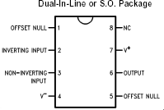
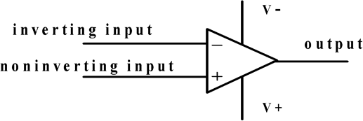



Pin Diagram of LM 741

Slide 14
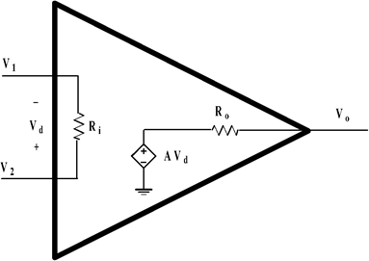





Operational Amplifiers
A model of the op amp, with respect to the symbol
V_{o}= AV_{d}

Slide 15
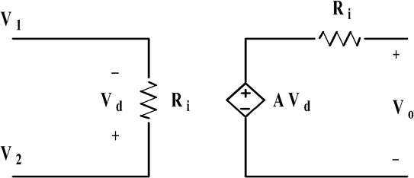
Working circuit diagram of op amp.

Slide 16
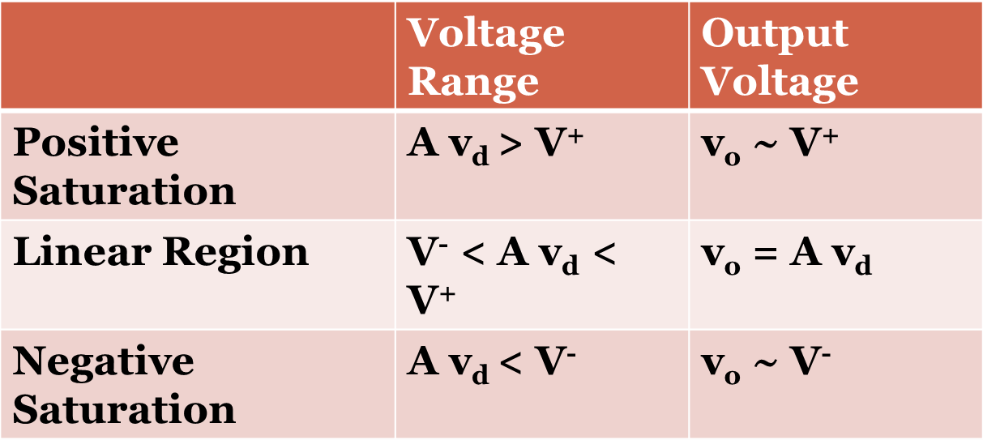

Open Circuit Output Voltage
The voltage produced by the dependent voltage source inside the op amp is limited by the voltage applied to the positive and negative rails.

Slide 17
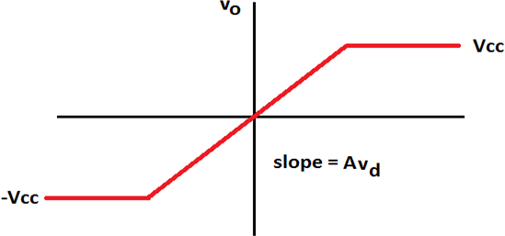





Voltage Transfer Characteristic

Slide 18
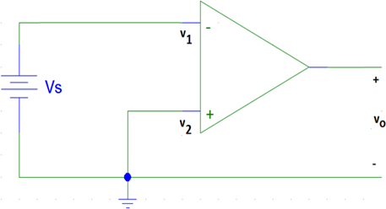









Example: Voltage Comparator
.
When V1 is equal to V2, Vo = 0V When V1 is smaller than V2, Vo = V⁺. When V1 is larger than V2, Vo = V⁻.

Slide 19
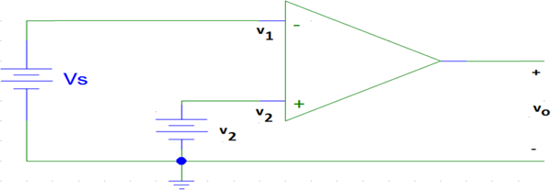




Electronic Response
Given how an op amp functions, what do you expect V_{o} to
be if v₂ = 5V, A=10 when:
V_{s} = 0V?
V_{s} = 5V?
V_{s} = 6V?

Slide 20
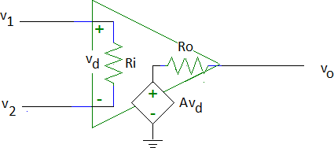






Ideal Op Amp
R_{i}=∞Ω
Hence i₁=i₂=0A
R_{o}=0Ω
i₁ = 0
i₂ = 0

Slide 21
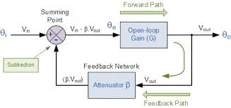
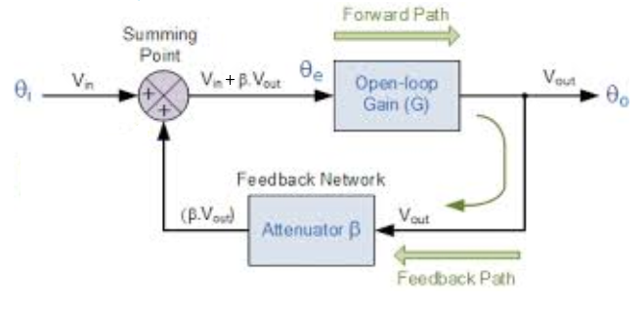













FEEDBACK IN CIRCUITS
Positive feedback
Negative feedback

Slide 22
Why Negative Feedback?
Gain of op amp (open loop gain) is of the order of 10^6 which is enough to drive the op amp into saturation.
We want the operation of op amp to be in the linear region for proper amplification purpose.
So to reduce gain we apply negative feedback.

Slide 23
Why positive feedback?
32
» When we want the amplifier to work in saturation only then we use positive feedback.
» It decreases the bandwidth and increases the overall amplification.
» G_{pf}= A/(1-Aβ)

Slide 24
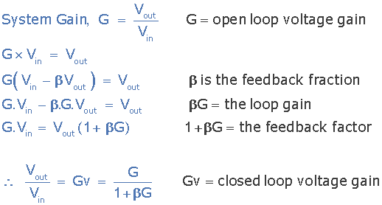


Negative Feedback Equation
We see that the effect of the negative feedback is to reduce the gain by the factor of: 1 + βG.
This factor is called the “feedback factor” or “amount of feedback” and is often specified in decibels (dB) by the relationship of 20 log (1+ βG).

Slide 25
Applications of Negative Feedback:-
Inverting Amplifier
Non-Inverting Amplifier
Adder , Subtractor
Log , Antilog
Integrator, Differentiator
Temperature sensor
Instrumentation amplifier
Active Filters

Slide 26
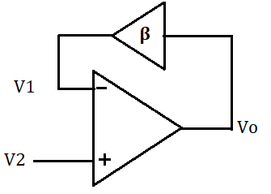
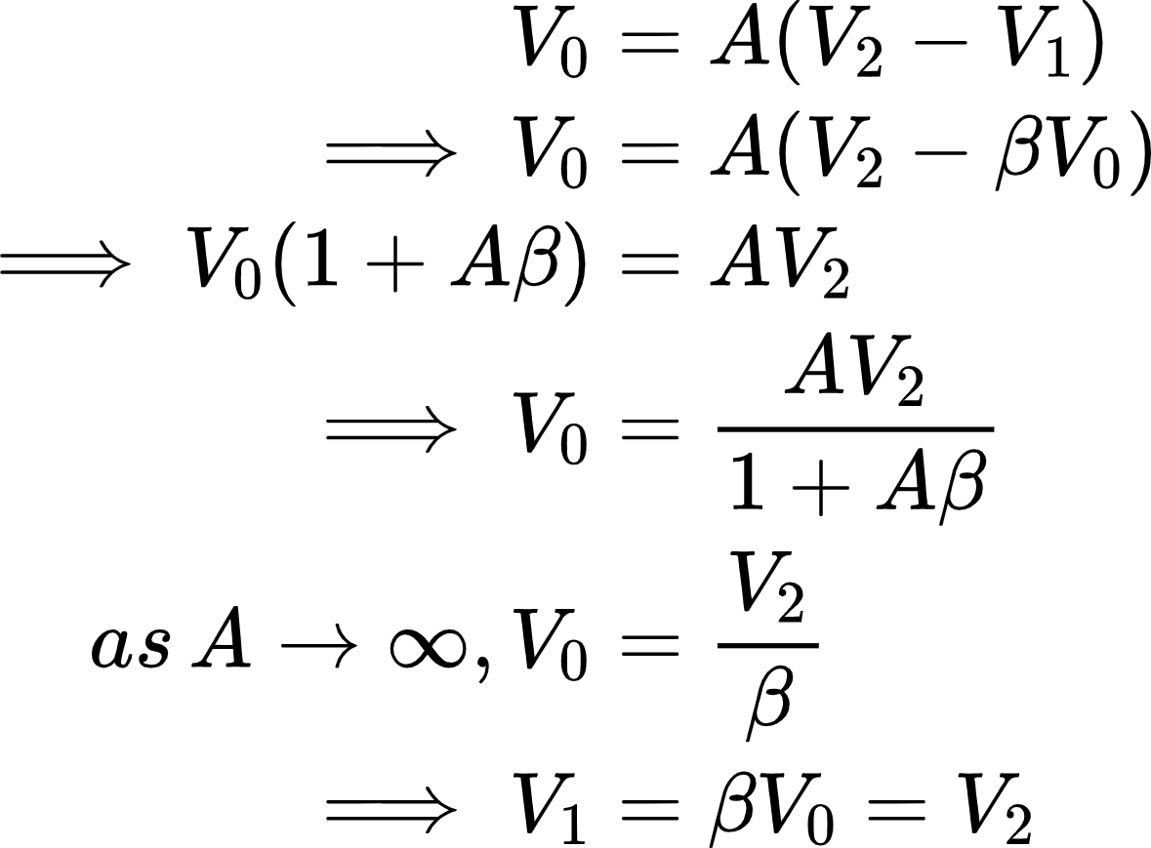












Virtual Short Circuit in Ideal OpAmp

Slide 27
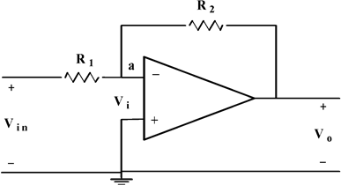
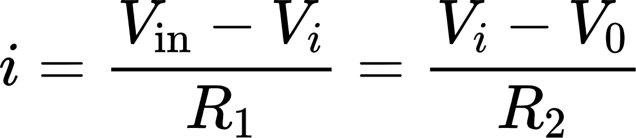



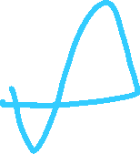
Inverting amplifier:
Writing a nodal equation at (a) gives;
With V_{i} = 0 we have;

Slide 28

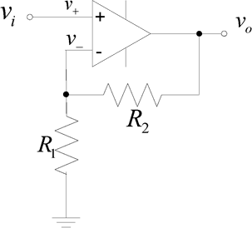






Non-inverting Amplifier
Closed-loop voltage gain

Slide 29
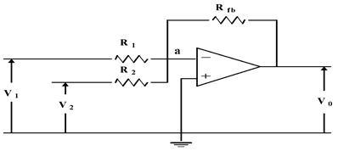









Summing Amplifier
If R₁ = R₂ = R_{fb} then,
Therefore, we can add signals with an op amp.

Slide 30
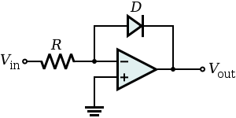
















Logarithmic Amplifier
Logarithmic amplifier gives the output proportional to the logarithm of input signal.
If V_{i} is the input signal then the output is
V_{o} = K*ln(V_{i})
where K is gain of logarithmic amplifier.

Slide 31
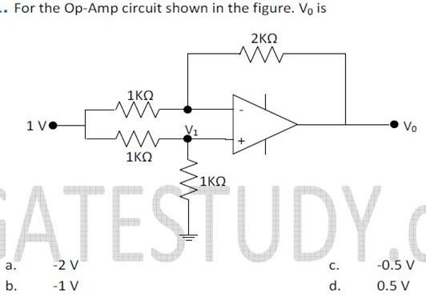




Questions
33

Slide 32
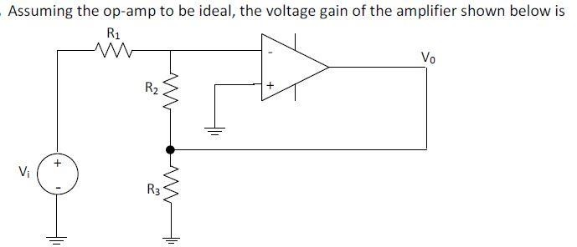












Questions
37

Slide 33
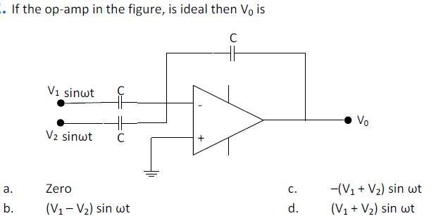










Questions
34

Slide 34









Slide 35
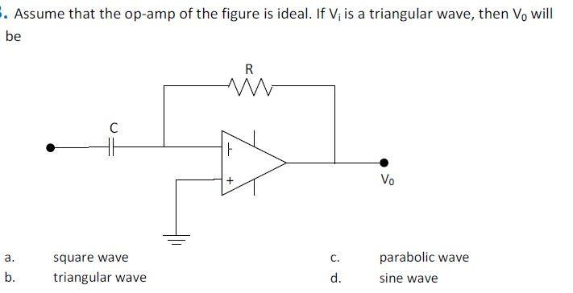






Questions
35

Slide 36











Slide 37









Alternate proof for virtual short circuit in Ideal OpAmp
In ideal OpAmp, R_{i}=∞Ω (approx), and currents in input terminals are zero, then potential difference between the terminals V_{d}=0V, hence V₁=V₂.

Slide 38
Thank You! ☺
Contact us:
Mohit Shringi: 6377566533
Rishabh Borad: 9450336209
P. Shyam Prasad: 9494146711

